Slide 1
Stepwise Process for Improving the Quality of Rapid and Recency Testing (SPI-RRT)
A Continuous Quality Improvement (CQI) tool for national certification of HIV Rapid and Recency testing sites

Slide 2
Content Overview
SPI-RRT Checklist
Data Management
Implementation Considerations
Country Case Study

Slide 3
SPI-RRT Checklist

Slide 4

Standard Audit Checklist for Quality Improvement
Identify areas where improvement is needed
Develop and implement a work plan to address gaps
Implement quality assurance elements
Use data to monitor quality progress
Maintain continuous quality improvement
Notes:
the checklist was first introduced as SPI-RT thru the RTCQI initiative. SPI-RT is one of the key pillars of RTCQI to monitor quality compliance and certify HIV rapid testing sites. We worked in collaboration with key quality champions here at ILB like Dr. David Turgeon who is our lab director, Dr. Larry Westerman who is part of the data team, Dr. Bharat Parekh who is now associate chief of innovative science, Katy Yao part of the Health Systems strengthening team and Dr. Mireille Kalou who is the lab adviser for Haiti. We wanted a checklist that focused on those resource limited setting where HIV rapid testing was happening since it was important to…(read slide)… and ensure that the client gets the right result.

Slide 5
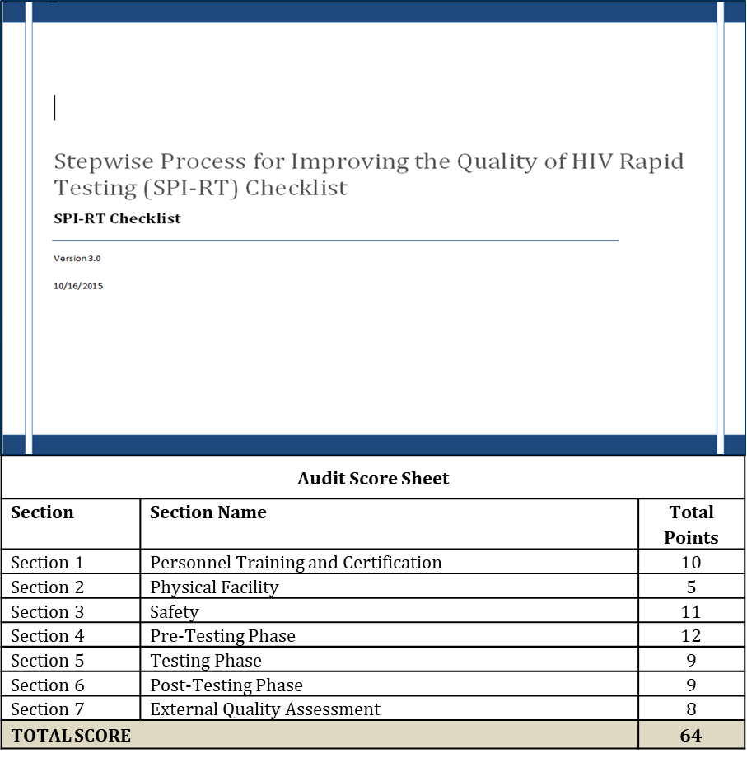
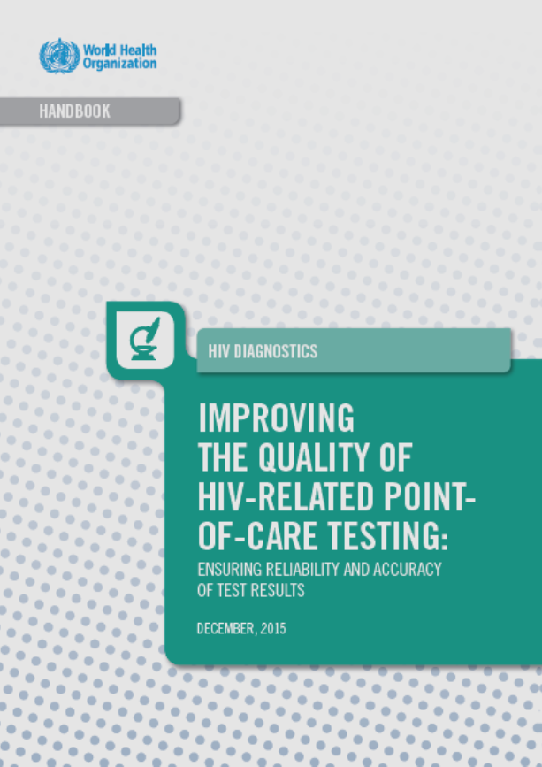
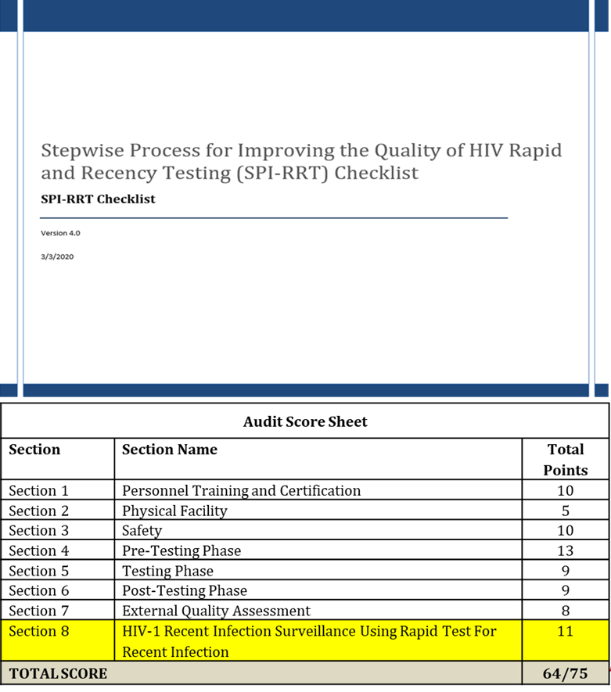
SPI-RRT Checklist
SPI-RT is accepted by WHO and is included in the QA handbook
Provides guidance on QA practices
Guide for development of policies and procedures to address gaps identified at the site
SPI-RT revised to include the HIV-1 recent infection surveillance component (SPI-RRT) and has been submitted to WHO to update handbook
Notes:
After SPI-RT was developed and rolled out during our implementation of RTCQI it was accepted by WHO in 2015 and included in their quality handbook, Improving the Quality of HIV related point-of-care-testing. Last year we had an opportunity to revise the handbook based on lessons learned from rTCQI implementation and include quality measure for the rapid test for recent infection
Approved by WHO to evaluate a site against quality standards required for improvement
Guidance QA practices for HIV RT/RTRI testing sites
One of the key pillars of RTCQI for certification of HIV rapid and recency test sites
Acts as a guide for development of policies and procedures to address gaps identified at the site

Slide 6
SPI-RRT Section Standards
Personnel Training and Certification
HTS should be offered by testers with adequate and documented training, competent skills, and certified.
Physical Facility
The testing site is adequate to provide a safe and effective HTS services.
Safety
The testing sites implements infection prevention and control processes.
Pre-Testing
All safety and specimen collection procedures are followed, test kits and consumables are adequate to provide accurate and reliable test results
Testing
All safety and testing procedures are implemented during throughout testing
Post-Testing
Documents and procedures (SOPs/job aides) regarding reporting and reviewing results are implemented
External Quality Assessment
Testing sites are periodically audited for performance and Audited if quality assurance procedures are followed and documented
HIV-1 Recent Infection Surveillance
All safety and testing procedures for RTRI are implemented throughout the testing process
Notes:
These are the section standards for each component of the checklist

Slide 7
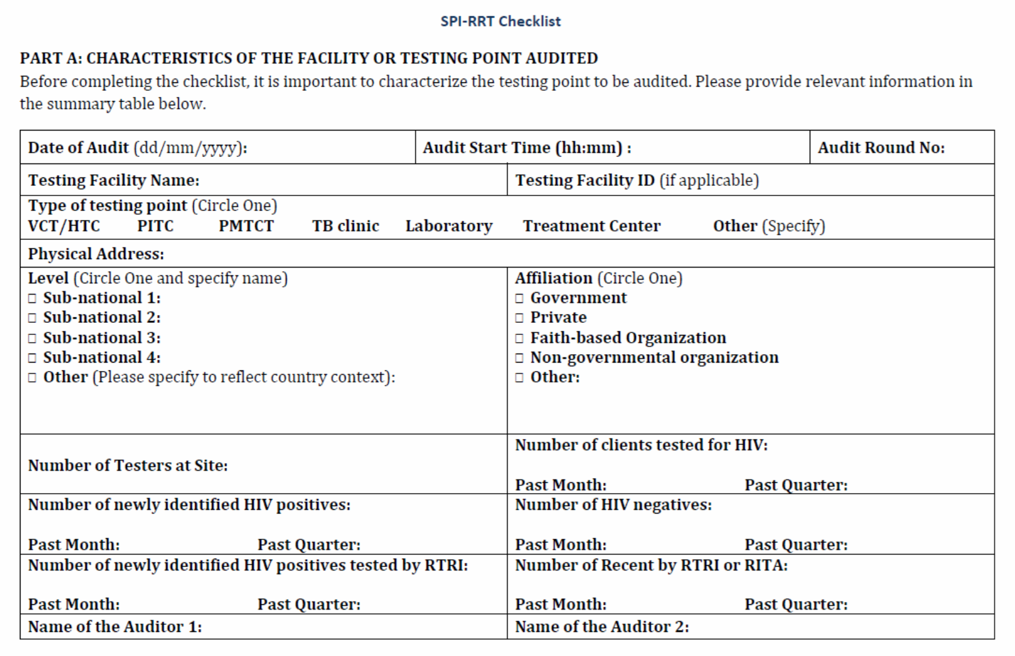



Notes:
Part A is where we are collecting demographic data of the site……go thru each section
At the bottom we are collecting certain testing data elements. Describe the data elements…..We use this data to monitor data quality and possibly use it to determine recent infection as a % of positives and as a proxy for incidence as % of at-risk population which we can discuss at another time.

Slide 8
Organization of the SPI-RRT Checklist: Part B
Yes = 1 point
When all elements are satisfactorily present
Partial = 0.5 points
Some but not all elements present, inconsistent implementation or non-adherence to procedures
No= 0 point
No elements present
Provide comments for each “Partial” or “No” response.
Notes:
So for each question in each section you would respond yes, partial or no

Slide 9
Organization of the SPI-RRT Checklist: Part C
Audit Score Sheet
Section | Section Name | Total Points
Section 1 | Personnel Training and Certification | 10
Section 2 | Physical Facility | 5
Section 3 | Safety | 11
Section 4 | Pre-Testing Phase | 13
Section 5 | Testing Phase | 9
Section 6 | Post-Testing Phase | 9
Section 7 | External Quality Assessment | 8
Section 8 | HIV-1 Recent Infection Surveillance | 11
TOTAL SCORE |  | 64/75
Total score expected = b
64 if no RTRI testing
75 if RTRI testing
Total points scored = a
Add total points from each section → Yes=1 point, Partial 0.5 point, No = 0
% Scores = (a/b) x 100
Certification Levels
Notes:
The percent score obtained by the audited testing point will correspond to a specific performance level
This checklist consists of five different levels to indicate status toward national certification.
What do these scores really mean and how do you translate them to actionable measures for CQI.

Slide 10
Organization of the SPI-RRT Checklist: Part D
Summary sheet to be filled out at the site before the de-brief
Ideally 2 copies: 1 for site and 1 for auditors
Recorded Duration of Audit from start of in-brief to out-brief
  Also record for each testing point the checklist auditing time
  Indicate the correct pre-certification level obtained by the site

Slide 11
Organization of the SPI-RRT Checklist: Part D
Section No. | Deficiency/Issue observed | Auditor’s Comments | Correction Actions |  | Recommendations
 |  |  | Immediate | Follow up | Actions | Timeline / Person responsible
Best practices, deficiencies observed
Corrective actions
Timelines
Point of contact for follow up
Can be corrected by site directly and quickly
Corrective Action may need coordinator support
Corresponds to Question number
Suggested Corrective Action
Who can support corrective action:
Site,
HTS coordinator
HTS Program
Laboratory
NRL
From comments taken during audit
Any additional information from the auditor on the root cause of the issue
Notes:
Scenario- Corresponds to question 5.3 and 5.4. Tester not using the correct specimen collection device for Determine rapid test. Additional information – stock out issue of capillary tubes. Corrective action – immediate. Recommendation action – onsite refresher training, timeline person responsible- auditor and person in-charge to observe testing for a period of time to ensure tester understood procedure and following it correctly, ensure that there is a system in lace to forcast the amt of capillary tubes needed and when to order to prevent future stock outs.

Slide 12
SPI-RRT User Guide

Slide 13
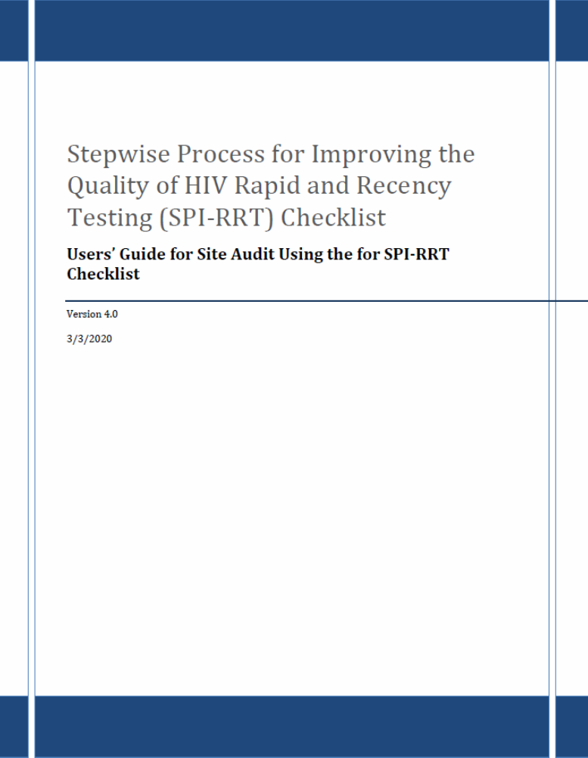
SPI-RRT USER GUIDE
Guidance Quality Assurance practices at
HIV testing sites
Notes:
User guide to help standardize our scoring and base our corrective actions on a set of quality standards….

Slide 14
Section 1.0 Personnel Training and Certification
Notes:
Data driven advocacy to invest
in QA programs

Slide 15
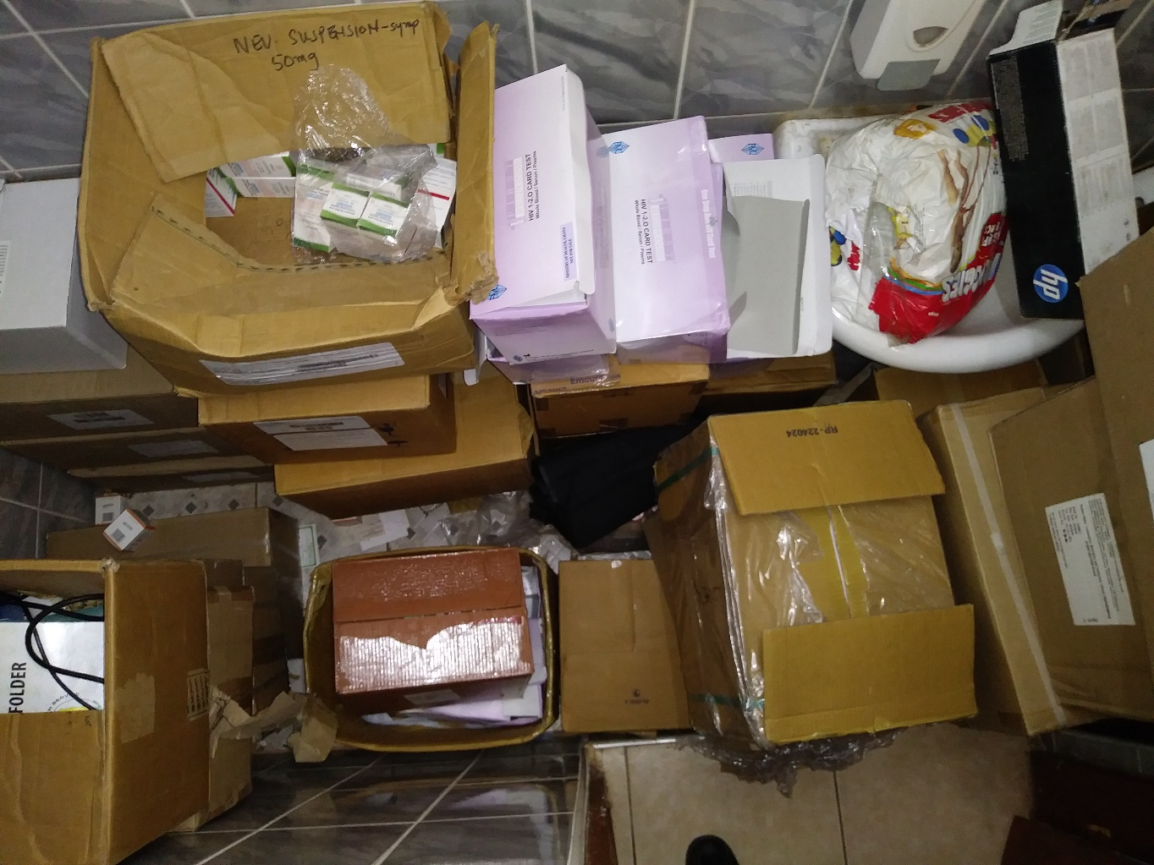
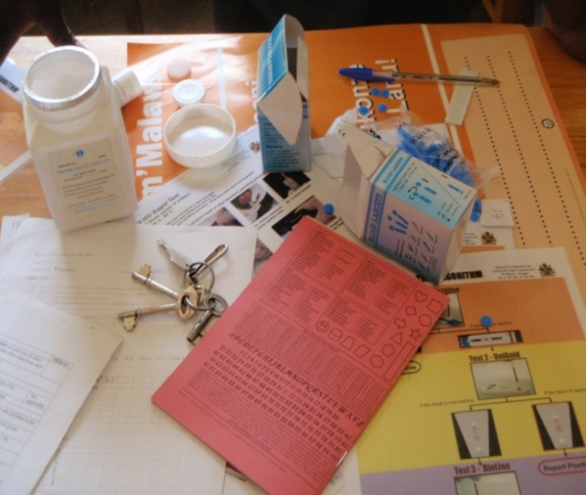
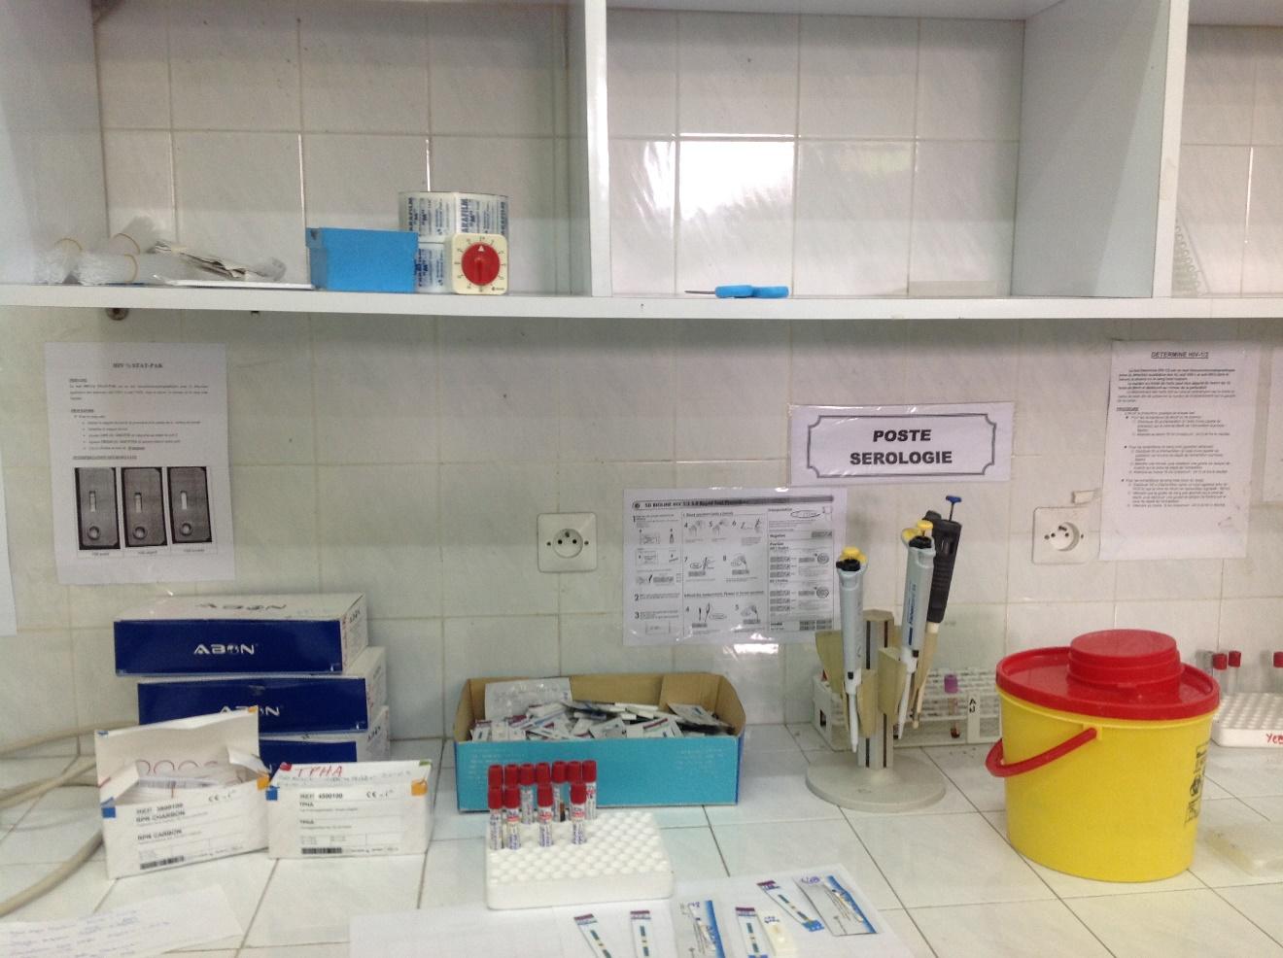
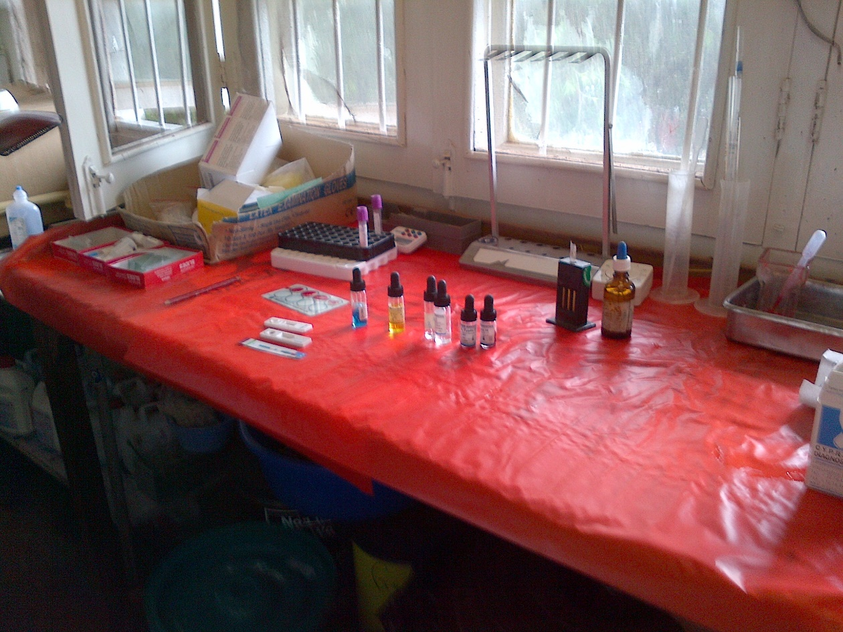
Section 2.0 Physical Facility

Slide 16
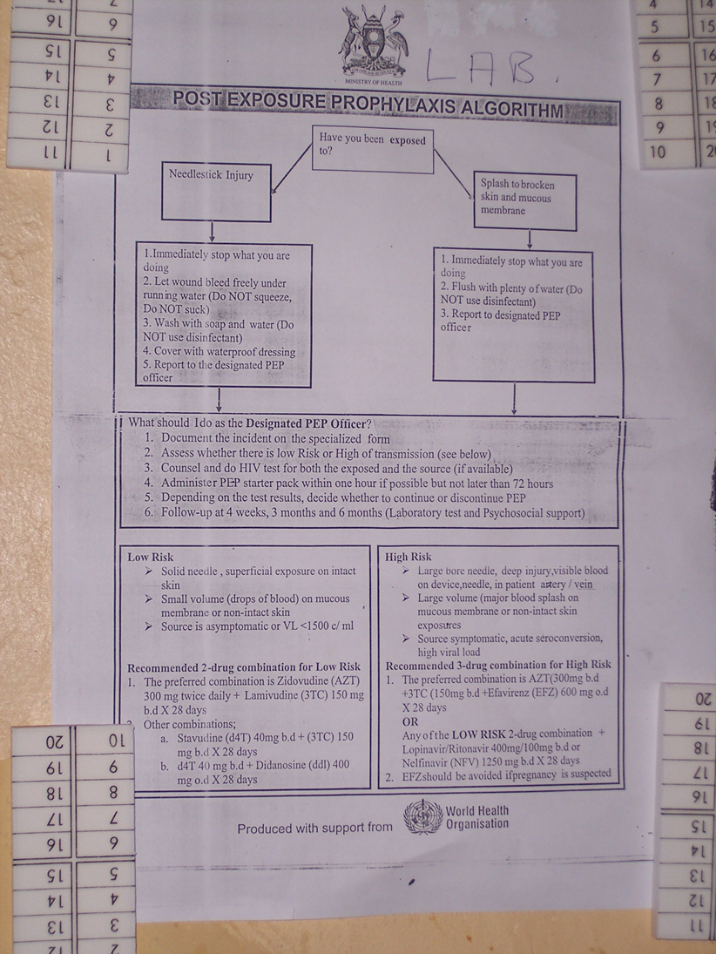
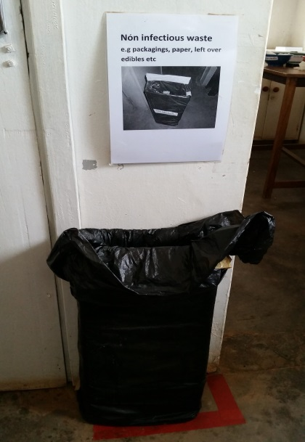
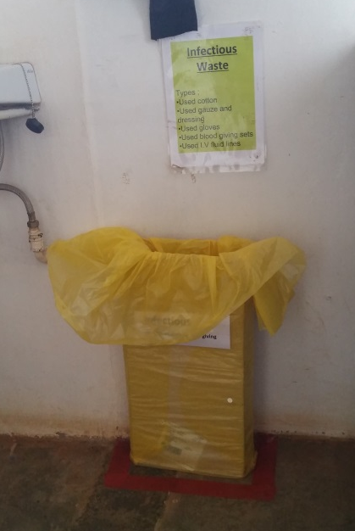
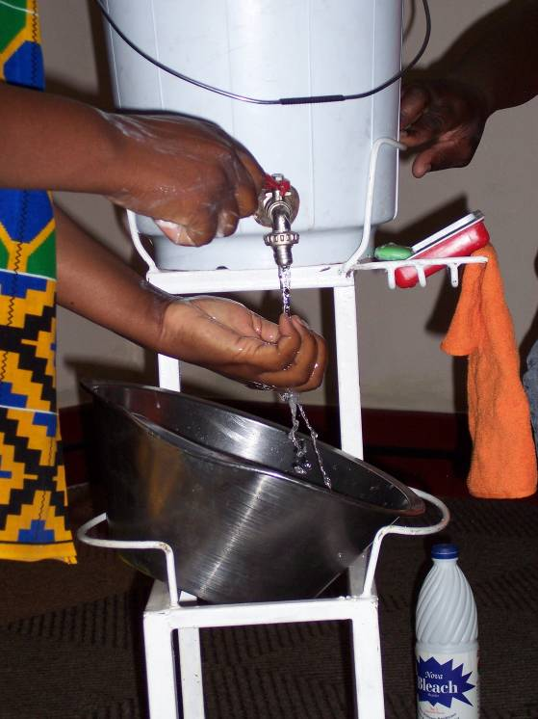
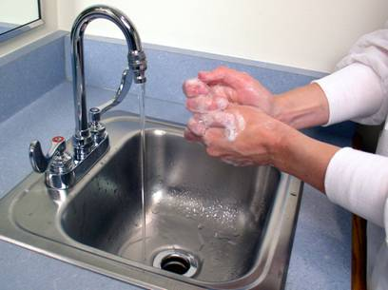
Section 3.0 Safety

Slide 17
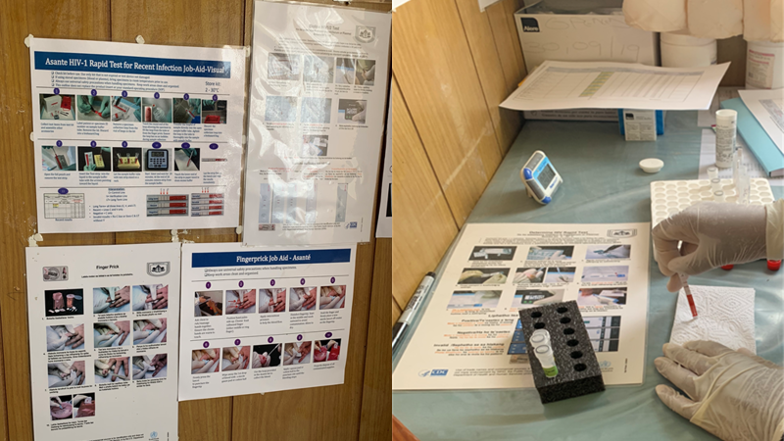
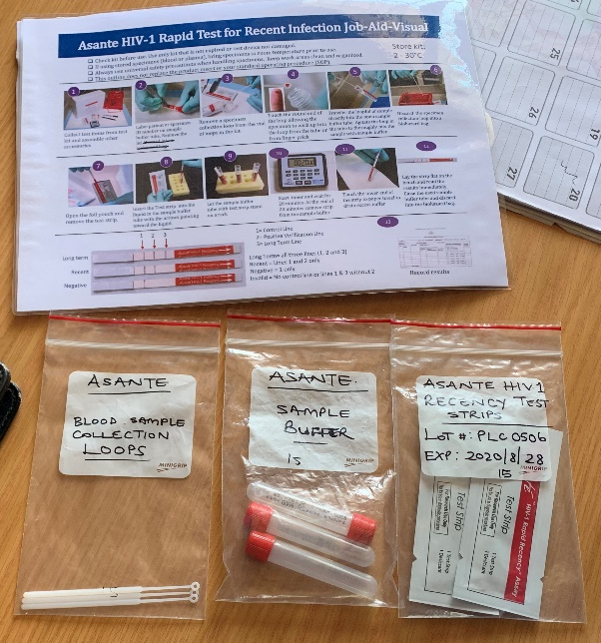
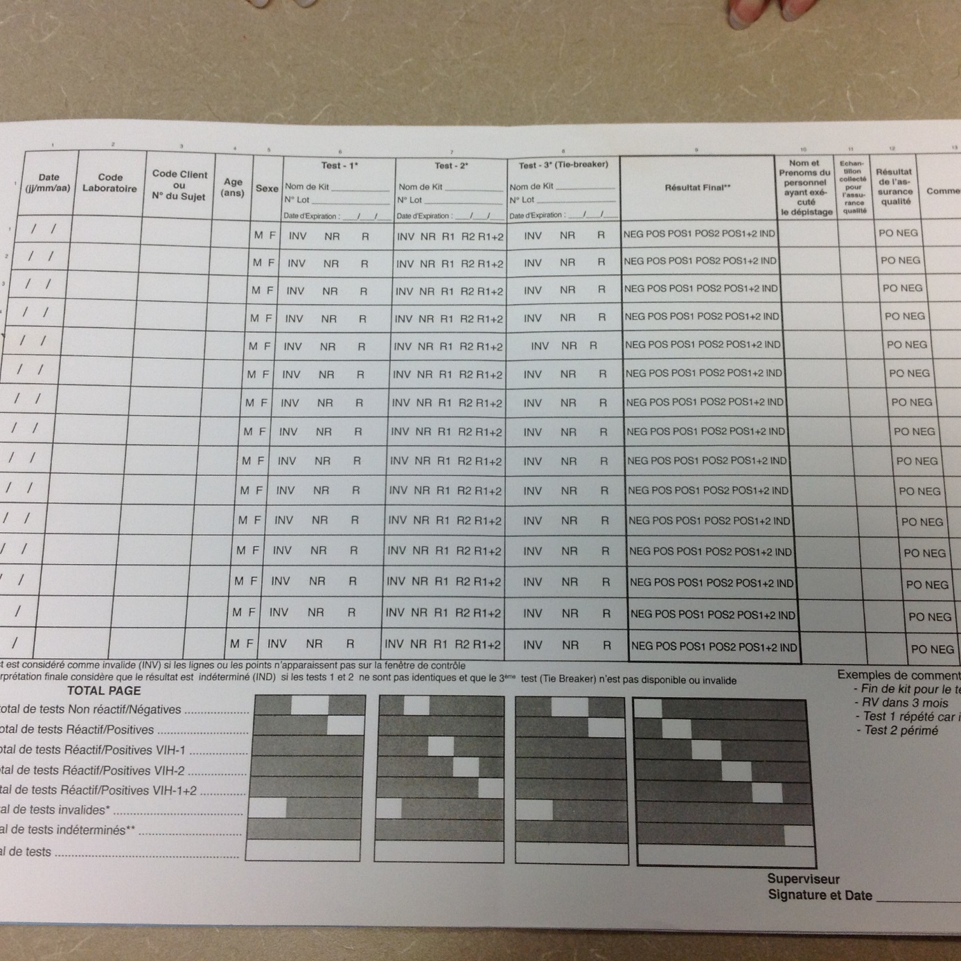
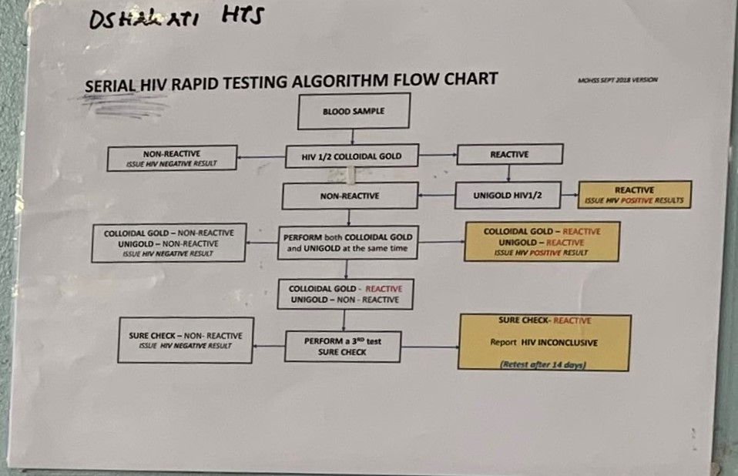
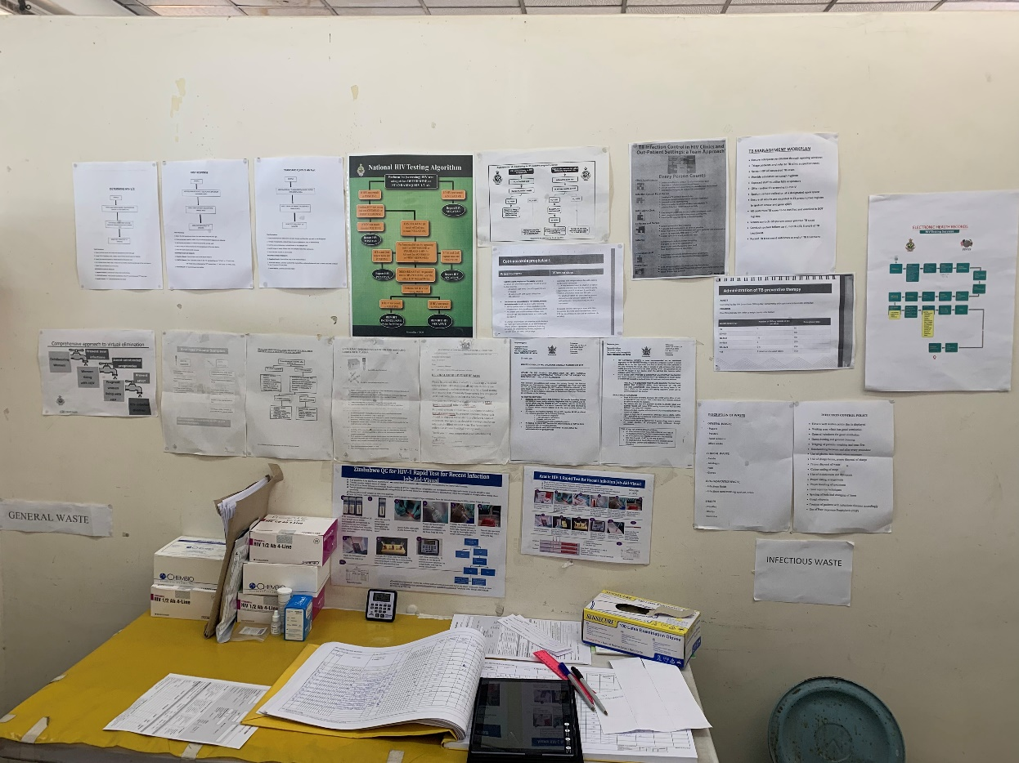
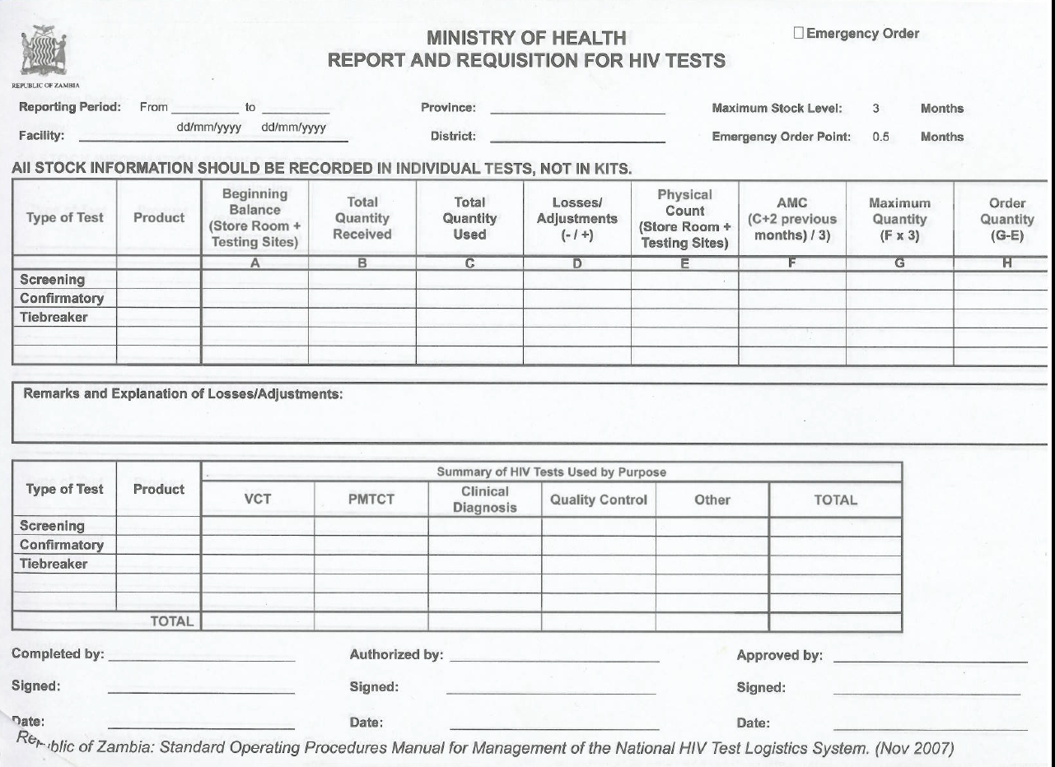
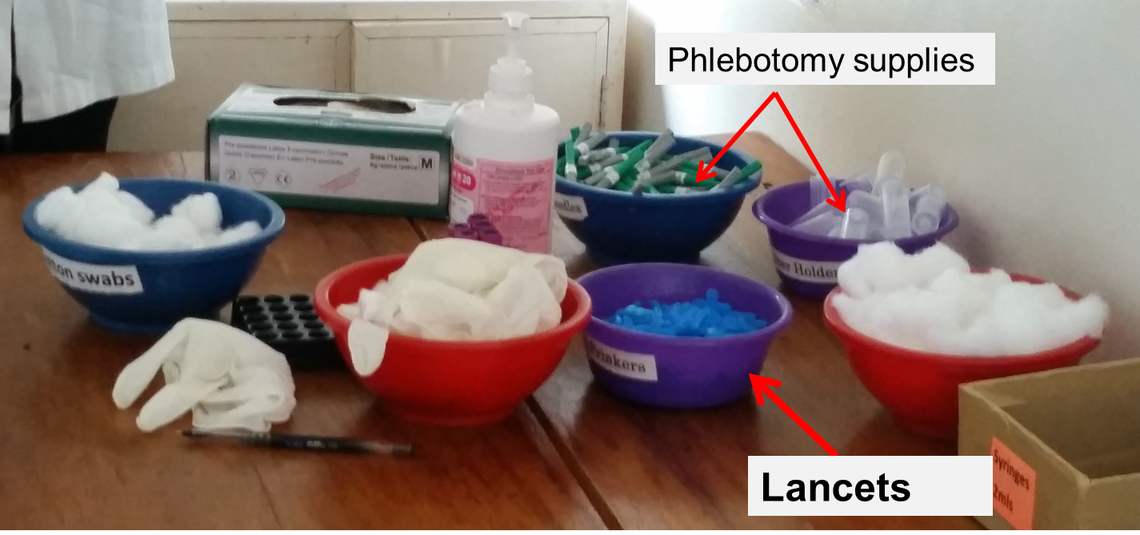
Section 4.0 Pre-Testing Phase

Slide 18
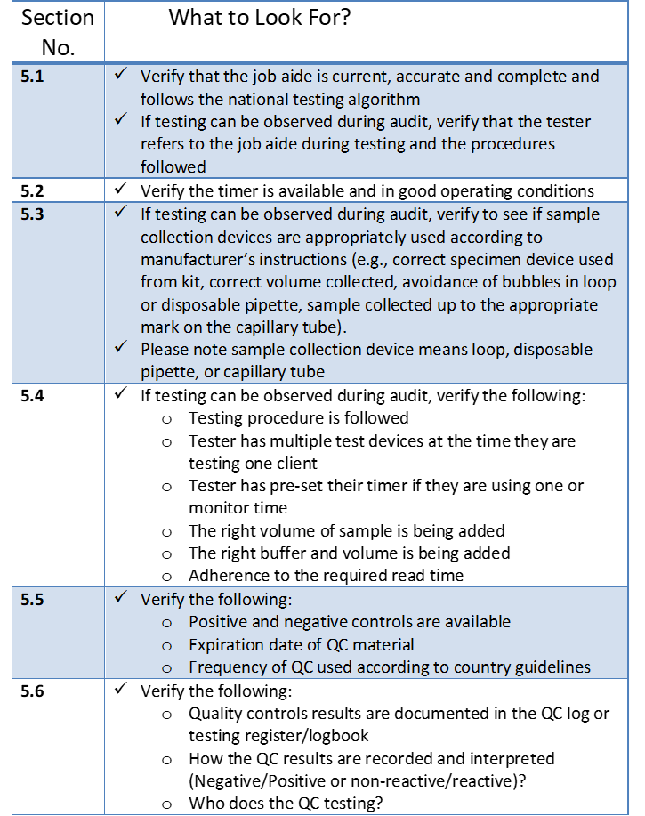
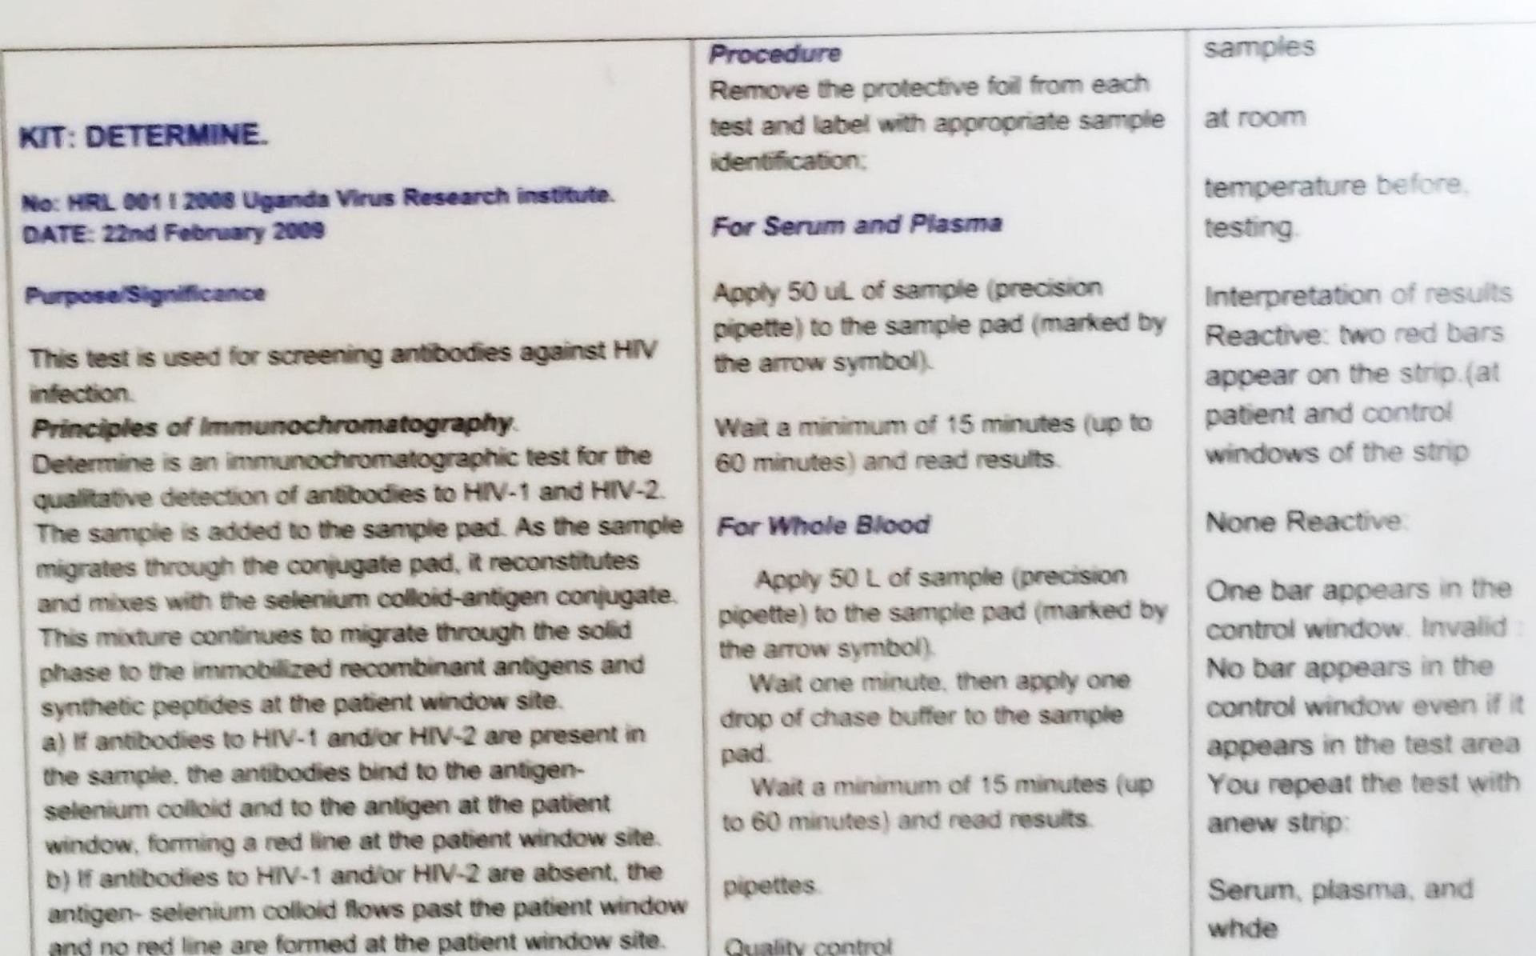
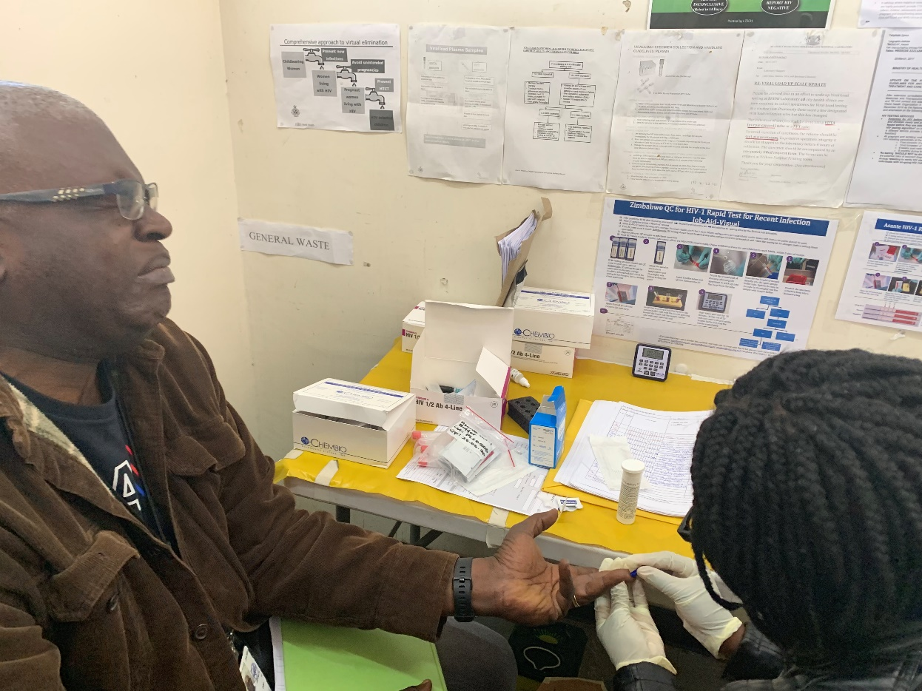
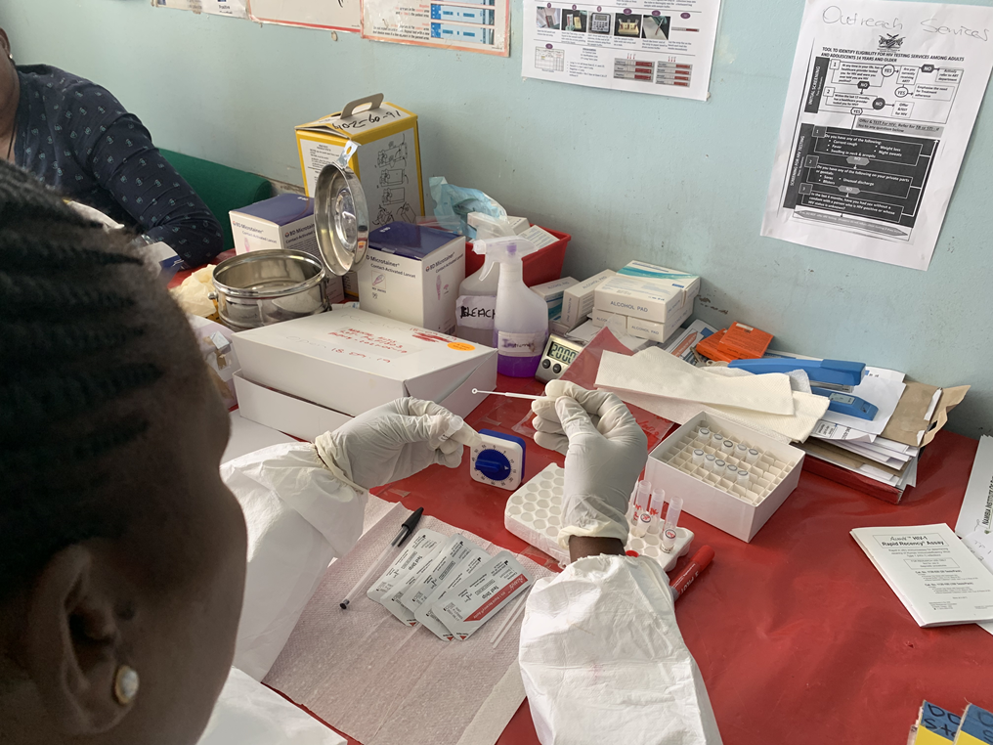

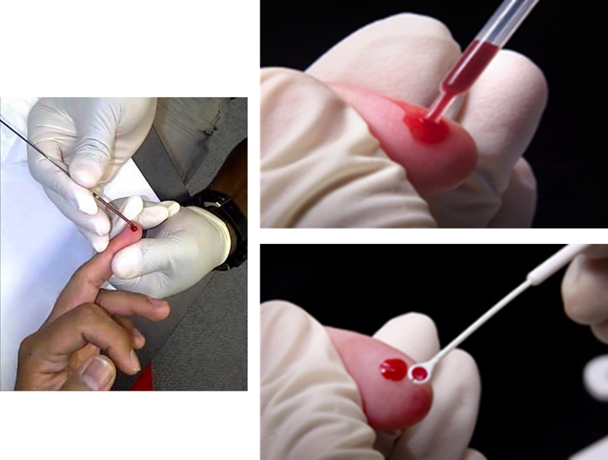
Section 5.0 Testing Phase
Apply 50µl of samples (precision pipette) to sample pad (marked by the arrow symbol).

Slide 19
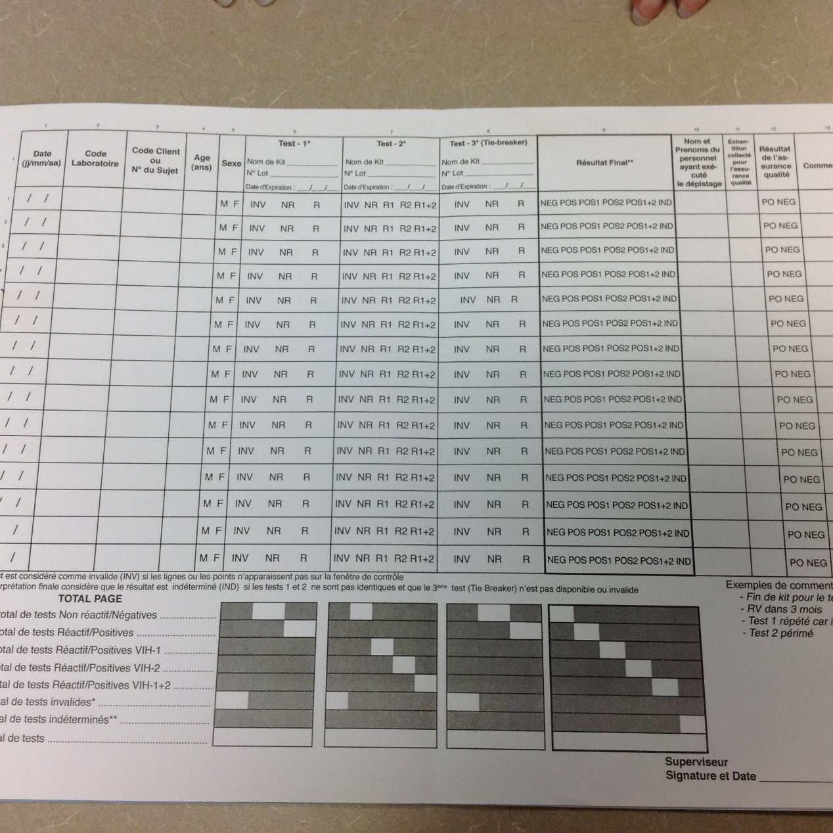
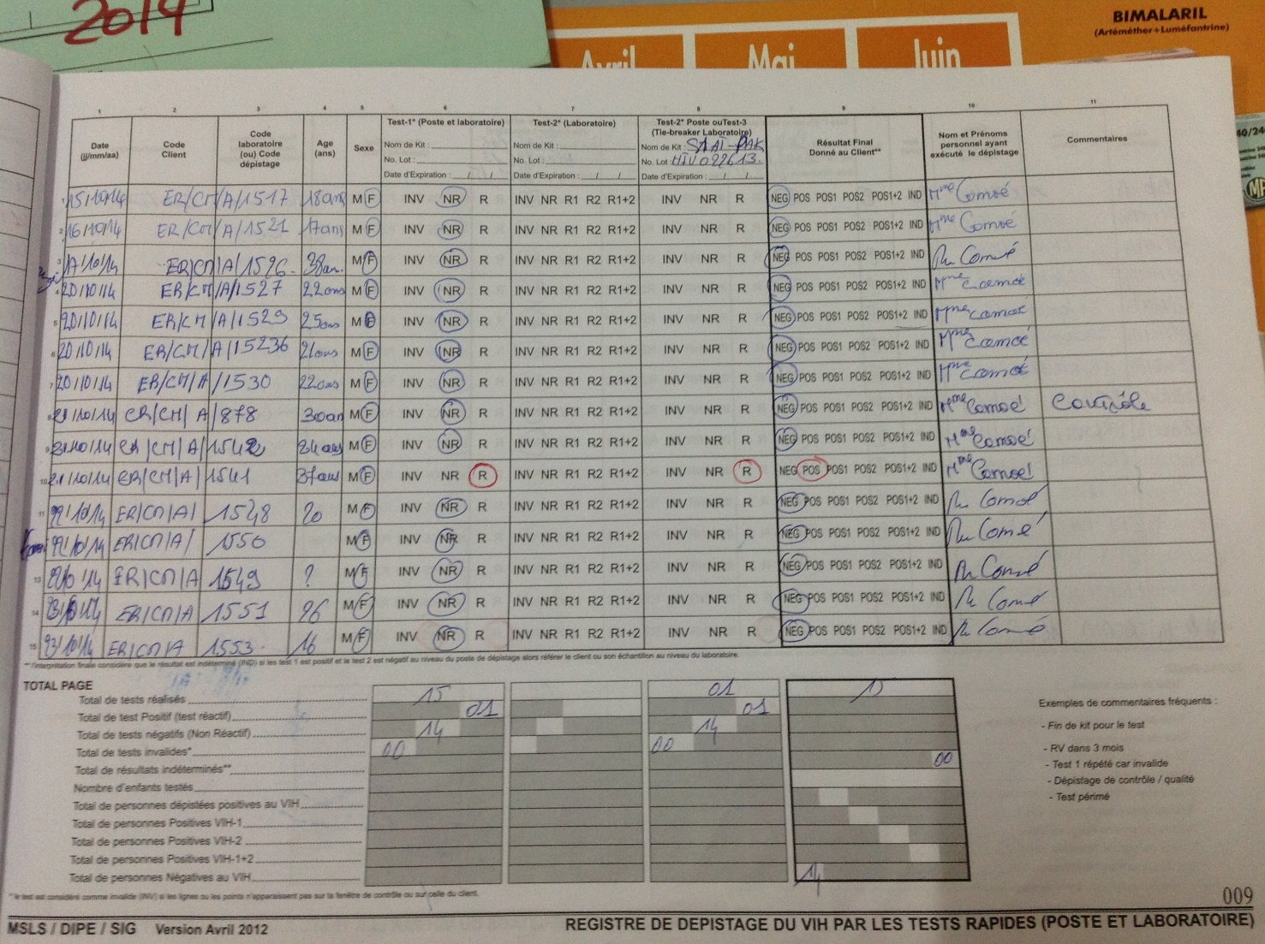
Section 6.0 Documents and Records

Slide 20
Section 7.0 External Quality Assessment

Slide 21
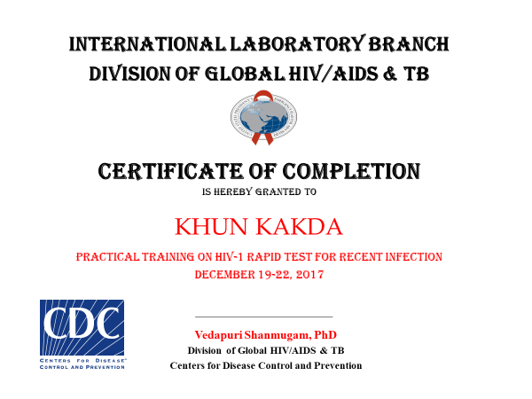
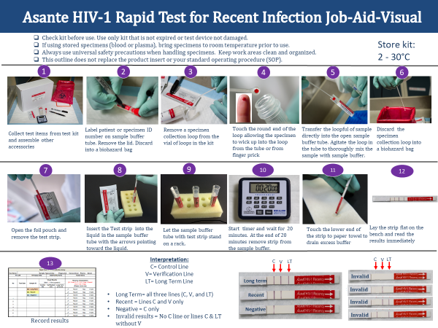
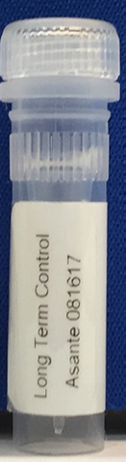
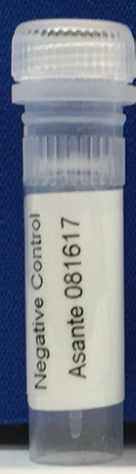
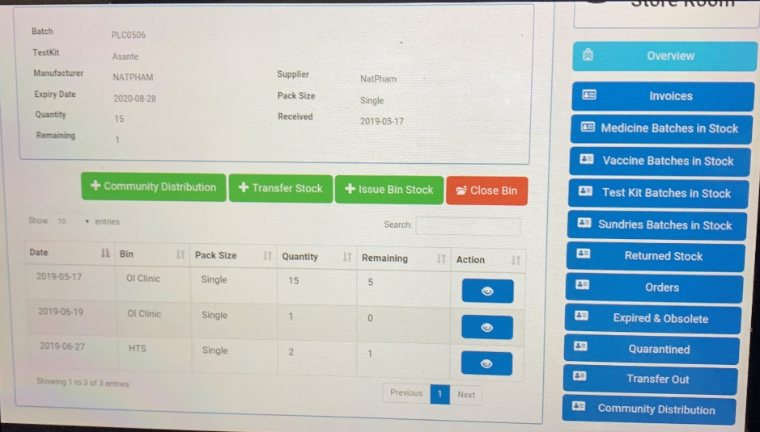
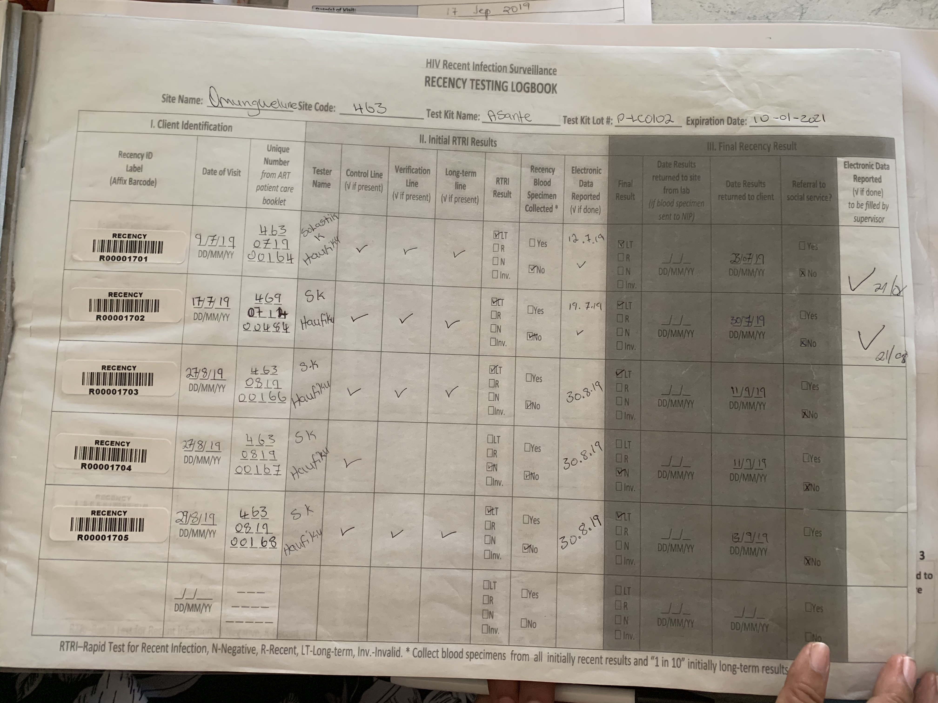
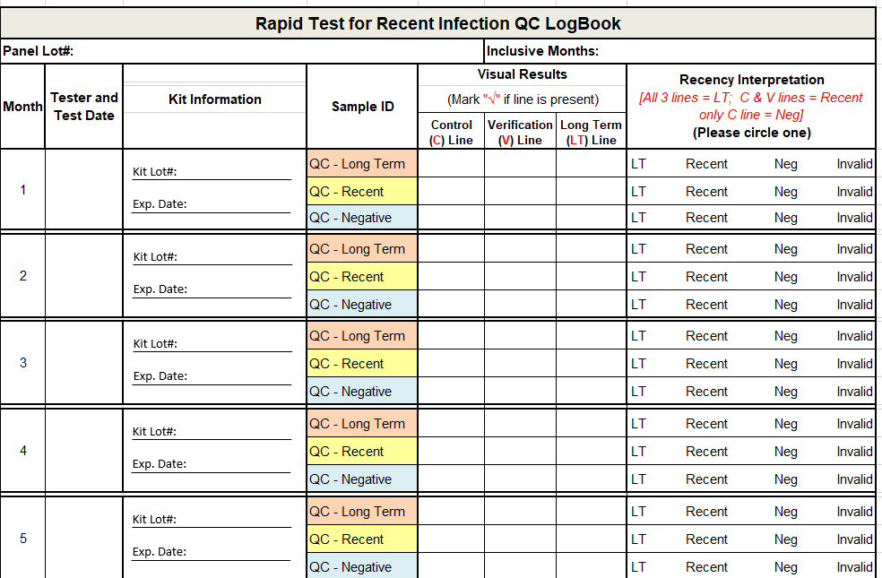
Section 8.0 HIV-1 Recent Infection Surveillance
Long Term Control Lot # 081617
Recent Control Lot # 081617
Negative Control Lot # 081617

Slide 22
Identify Areas for Monitoring for Recency
Site Level - RTRI Testing
Central Level - Viral Load Testing
Data Quality
  Testers trained and certified
  Availability and integrity of supplies
  QA process throughout the three phases of testing
  Recency data quality
  QC/PT data
  Implementation of corrective actions
  Testers trained
  Availability and integrity of supplies
  Sample quality
  Testing Workflow
  Maintenance of Equipment
  Data abstraction from recency data capture forms/logbook
  Completeness of data
    Missing results?
    Transcription errors?
    Does it make sense?
  Identifying gaps and implementing corrective action

Slide 23
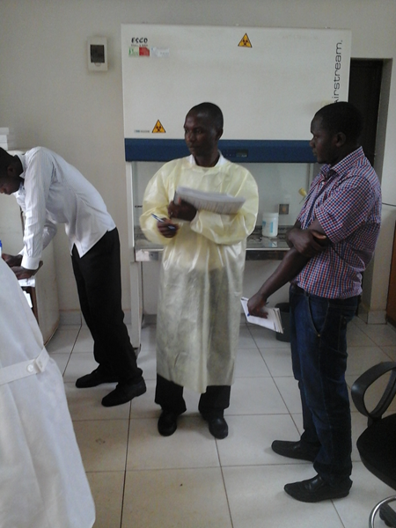

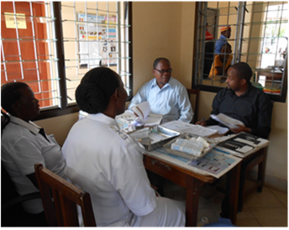

Site Audit Process
Dissemination of findings
Observe site operations
Direct Observation of Testing
Compiling audit responses and summary of corrective actions into ODK tablet application

Slide 24
Implementing Corrective Actions
Opportunity for mentorship and coaching to address gaps
Immediate corrective action vs. Follow-up
  Gaps that impact providing the right result to the client or the safety of the tester, client or environment
On site refresher training
  Safety Practices
  Proper blood collection
  Test procedures
  Documentation
    HTS register
    Data capture form or tablet ODK
Feedback = Opportunity for teaching moments
Knowledge is critical
  National guidelines
  Recency Protocol
  Procedures on safety, testing, documentation, etc.

Slide 25
Take home messages
The SPI-RRT checklist and Users’ Guide will:
Provide a solid foundation for ensuring the quality of HIV Rapid Testing by provide standards and requirements for Quality Assurance
Specify detailed to conduct an audit of the standards and requirement of QA for HIV RT
Serve as a tool to for Quality Improvement to support HIV RT site
Act as guidelines for development of policies and procedures

Slide 26
Data Management

Slide 27
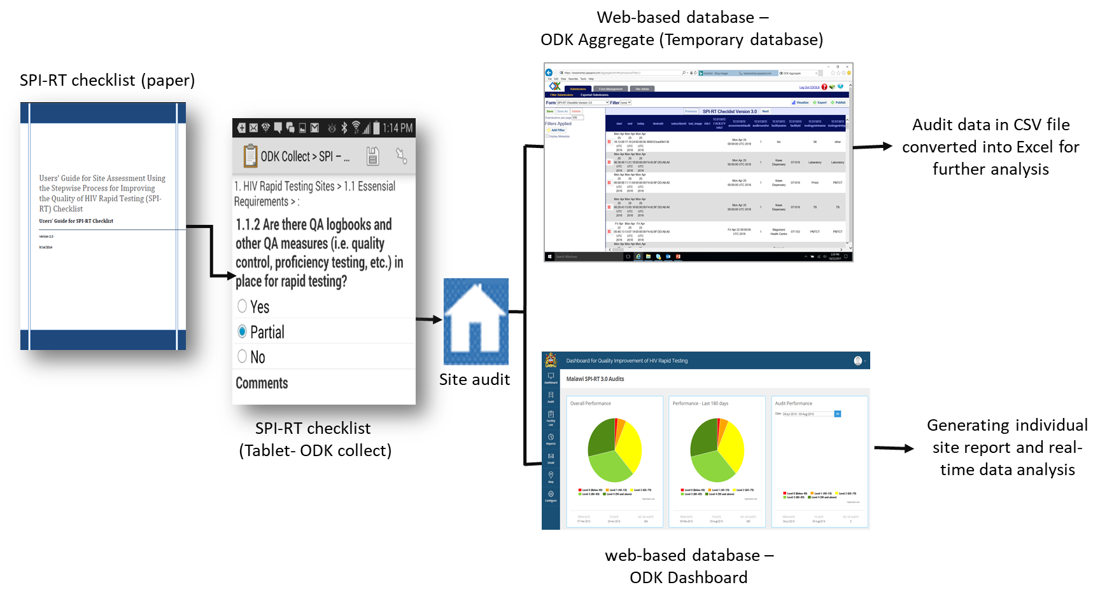
SPI-RT/SPI-RRT Audit Tools

Slide 28
Certifying Testing Sites Through a Stepwise Process
Implementation Considerations

Slide 29
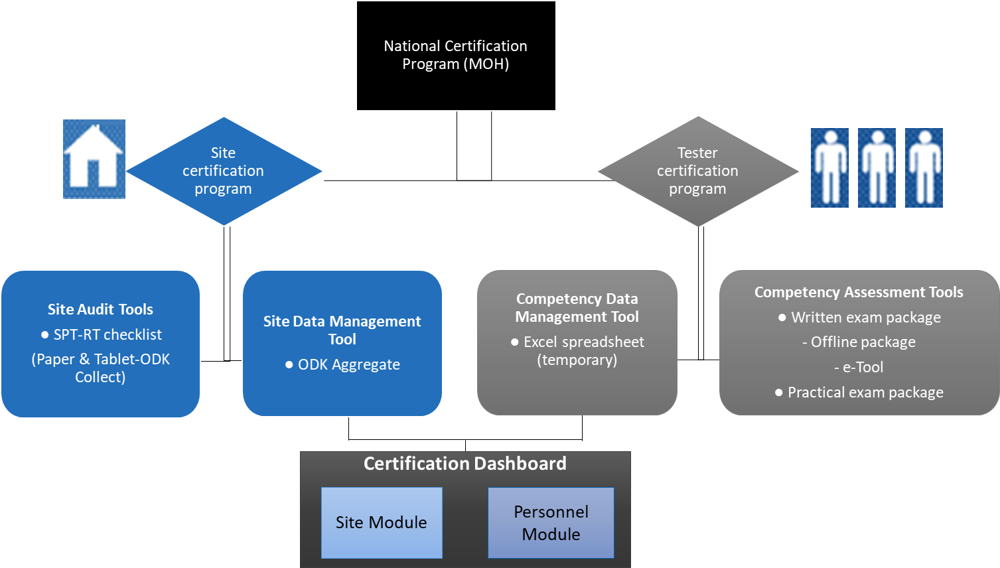
Overview of National HIV Certification Program

Slide 30


Road Map
Training of Auditors
Strengthening local capacity to scale-up nationally
Improvement plan
Site Certification
Baseline Audit
Follow up audits
Identification of sites and development of work plan
Regional sensitization and selection of sites
MOH Endorsement
Advocating for integration into national QA/QI framework and leveraging resources for CQI
Corrective action plan – refresher training, leveraging resources to address certain gaps, etc.
Corrective actions are implemented. Sites are in compliance to the QA standards
- All sites performing HIV RT and RTRI testing
- Phased implementation
- Regional level buy-in
- High volume
- High prevalence
Where are the gaps? Are sites following basic QA practices?
Positive impact of onsite mentorship and coaching
Continuous Quality Improvement (CQI)
Completing the Quality Assurance Cycle (QAC) at sites

Slide 31
Role of POCT Site Certification Stakeholders
Regional/District auditors
Conduct baseline audit
Develop improvement plan
Site
Implement improvement plan
Certifying body
Government entity
Identify national auditors
Audit site eligible for certification
Prioritize sites for certification
Review audit reports
Monitor site performance
Monitor improvement
Determine eligibility for certification
Notify certifying body
Generate audit reports
Issue certificate for eligible site
Develop corrective action for remediation
Send reports to government entity
Implement site specific QMS
Conduct internal audit using SPI-RRT
Confirm decertification decision
Appoint auditors
Review and approve auditor training curriculum

Slide 32
Frequency of Monitoring
Monthly
Internal audits by POCT site personnel
Quarterly
Mentoring by sub-national team including Q-corps
Semi-Annual
SPI-RRT Level 3
Audits by subnational team (regional or district)
Audits by sub-national team (regional or district level)
Annually
Mentoring by facility lab staff, IPs, QA officers or quality mentors
SPI-RRT Levels 0 and 1
SPI-RRT Level 2
Bi-Annually
SPI-RRT Level 4
Certified POCT Site
Certified POCT sites
Internal audits by POCT site to ensure compliance and meet recertification eligibility requirements
Mentoring by sub-national team including Q-corps
Audits by certifying body
Initial certification
Audits by certifying body
Recertification

Slide 33







192 certified auditors
3280 sites audited
33 auditors certified
150 sites audited
Auditors and Audit Numbers by Country
21 auditors certified
271 sites audited
34 auditors certified
69 sites audited
171 auditors certified
1639 sites audited
21 auditors certified
90 sites audited
43 auditors certified
193 sites audited
19 auditors certified
111 sites audited
90 auditors certified
2713 sites audited
Data from 2019 panorama and partners

Slide 34
Review
What is the purpose of SPI-RRT auditing?
What are the key elements of the SPI-RRT?
What are “What to ask for” and What to Look for”?
Name two elements of the SPI-RRT audit process?
What are the roles and responsibilities of the certification body?
What is the frequency of monitoring if a site achieves level 2 in the certification process?

Slide 35

Thank You

